Slide 1
Responsive Web Design
Flexible Grid
Notes:
Add instructor notes here.

Slide 2
Lesson Objectives
Flexible Grid
Flexible Type
Flexible Container
Flexible Container – Implementation
Flexible Margins and padding
Flexible Images
Notes:
Add instructor notes here.

Slide 3
2.1: Flexible Grid Flexible Grid
Ingredients needed to effectively create “Responsive Design” are:
A flexible grid – including layout and images
Media queries
Using a flexible grid we can ensure our site will re-size on its own
Four components that make up a flexible grid:
Flexible Type
Flexible Containers
Flexible Margins
Flexible Padding
Notes:
Add instructor notes here.

Slide 4
2.2: Flexible Type Flexible Type
Most common approach to styling type today is using pixels
But, using proportionate values in our text will save us many lines of code in our media queries.
If we want to have smaller or larger text based on screen size we only need to change the parent element.
Using proportionately sized type any change in our media query will affect all of the type in our base css file
Instead of pixels we can use ems
Use following formula:
target ÷ context = result
Target – the font size we ultimately want to be displayed by default Context – the base font size our browser recognizes (typically 16px for most browsers)
Notes:
Add instructor notes here.

Slide 5
2.2: History Example
if we want a headline in my site to be seen by default at 32px, and we want to express that size in em’s, then use this formula:
32px ÷ 16px = 2
When you use the formula and you come out with some long decimal point – keep the whole thing, without rounding it off. It will be more accurate
Note the formula next to the font size in your css for easy reference in case you want to change something later
font-size: 2em /* 32px/16px */
Notes:
Add instructor notes here.

Slide 6
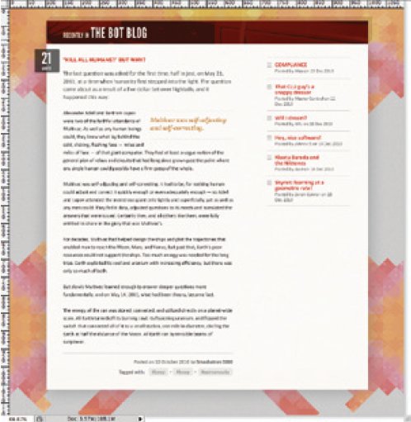
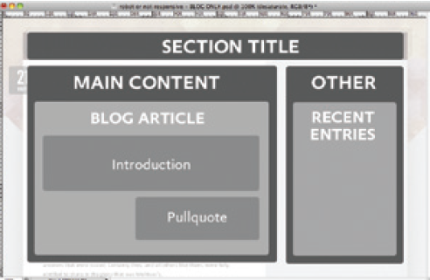
2.3: Flexible Container Flexible Container
Consider converting this blog design into a standards-based, flexible layout
Notes:
Add instructor notes here.

Slide 7
2.3: Flexible Container Flexible Container - implementation
Outline can be created as follows:
<div class="main">
…
</div><!-- /end .main -->
<div class="other">
…
</div><!-- /end .other -->
</div><!-- /end .blog.section -->
</div><!-- /end #page -->
total width is 960 pixels.
#page {
margin: 36px auto;
width: 960px;
}
.blog {
margin: 0 auto 53px;
width: 900px;
}
.blog .main {
float: left;
width: 566px;
}
.blog .other {
float: right;
width: 331px;
}
Notes:
We’ve created a generic container for the entire page (#page), which in turn contains our .blog module.
And within .blog we’ve created two more containers: a div classed as .main for our main article content, and another div classed as .other
Add instructor notes here.

Slide 8
2.3: Flexible Container Flexible Container - implementation
From pixels to percentages
we need to express those widths in relative, proportional terms
Then we will have a grid that can resize itself as the viewport does, but without compromising the design’s original proportions
If we consider:
#page {
margin: 36px auto;
width: 960px;
}
Can be converted to:
#page {
margin: 36px auto;
width: 90%;
}
Instead of a value set in pixels, we need to express .blog’s width of 900px in proportional terms:
target ÷ context = result
Notes:
Add instructor notes here.

Slide 9
2.3: Flexible Container Flexible Container - implementation
target pixel width for our blog: 900px,
#page element, we’ve got our context—namely, 960 pixels
divide our target width for .blog (900) by its context (960):
900 ÷ 960 = 0.9375
.blog {
margin: 0 auto 53px;
width: 93.75%; /* 900px / 960px */
}
#page {
margin: 36px auto;
width: 90%; /* random value */
}
.blog {
margin: 0 auto 53px;
width: 93.75%; /* 900px / 960px */
}
.blog .main {
float: left;
width: 62.8888889%; /* 566px / 900px */
}
.blog .other {
float: right;
width: 36.7777778%; /* 331px / 900px */
}
Notes:
We’ve created a generic container for the entire page (#page), which in turn contains our .blog module.
And within .blog we’ve created two more containers: a div classed as .main for our main article content, and another div classed as .other
Add instructor notes here.

Slide 10
2.4: Flexible Container Flexible Margins and padding
Context depends on whether you’re setting flexible margins or flexible padding:
When setting flexible margins on an element, your context is the width of the element’s container.
When setting flexible padding on an element, your context is the width of the element itself.

Slide 11
2.4: Flexible Container Flexible Margins
While determining the context for margins, you are going to use the width of element’s container
Lets use our alternate sidebar as an example.
Our element’s container is set to 150px, so that determines our context.
.widget-area ul {
margin: 10px 0 0 25px;
}
.widget-area ul {
margin: 10px 0 0 16.666667%;
}
formula would read:
(target) 25px divided by (context) 150px, and the result is a margin of 16.666667%
Notes:
Add instructor notes here.

Slide 12
2.4: Flexible Container Flexible Margins
.lede {
padding: 0.8em 48px;
}
48 ÷ 900 = 0.0533333333
.lede {
padding: 0.8em 5.33333333%; /* 48px / 900px */
}
Left margin can be set:
.date {
float: left; margin-left: -17.0886076%; /* 81px / 474px */
width: 14.556962%; /* 69px / 474px */
}
http://www.studiopress.com/design/flexible-grid.htm

Slide 13
2.4: Flexible Images Flexible Images
If we add an image to our web page:
<div class="figure">
<p>
<img src=“googledoodle.jpg" alt="" />
<b class="figcaption">Google doodles are tooooo good!</b>
</p>
</div>
With CSS set to:
.figure {
float: right;
margin-bottom: 0.5em;
margin-left: 2.53164557%; /* 12px / 474px */
width: 48.7341772%; /* 231px / 474px */
}

Slide 14
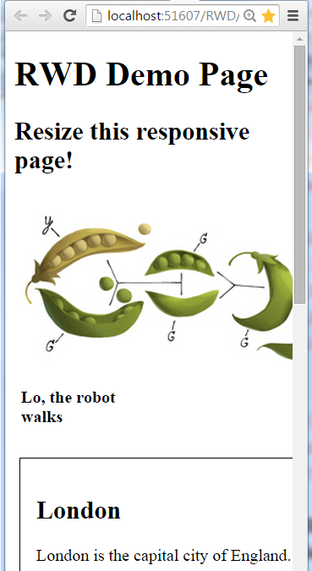
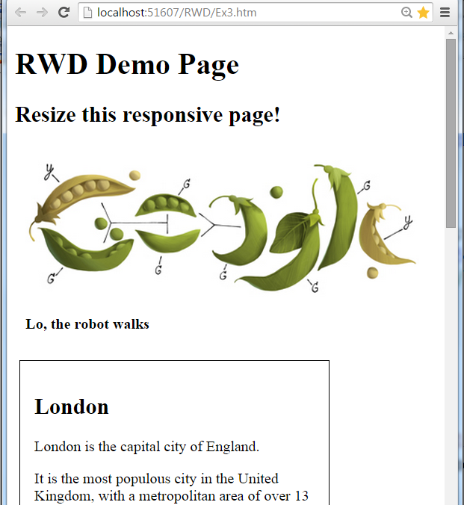
2.4: Flexible Images Flexible Images

Slide 15
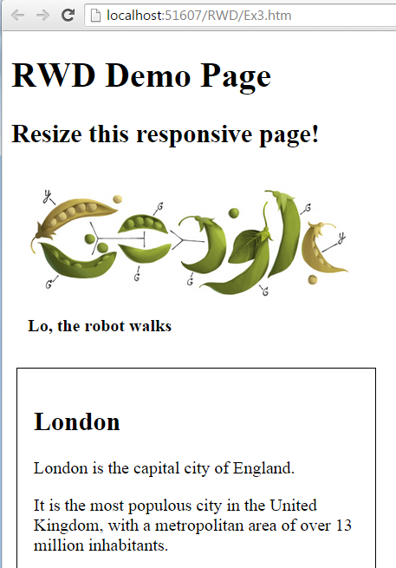
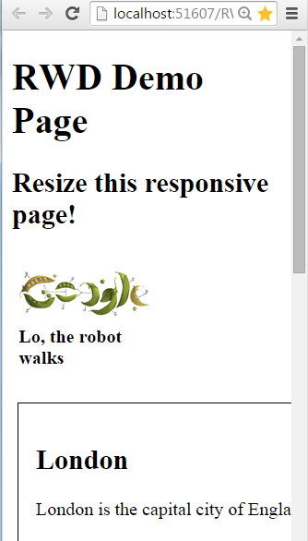
2.4: Flexible Images Flexible Images
img {
max-width: 100%;
}

Slide 16
Demo
Notes:
Add instructor notes here.

Slide 17
Summary
Four components that make up a flexible grid:
Flexible Type
Flexible Containers
Flexible Margins
Flexible Padding
Use em and % in flexible container
For flexible image, we can use max-width
Notes:
Add the notes here.
Add instructor notes here.

